Slide 1
Comparative Analysis of Plant Disease Detection Using XceptionNet, MobileNet, and CNN Model
CSE424 || section: 1 || GROUP 21 || FALL’23 Saiwara Mahmud Tuhee
20101465
Sad Md. Tafhim
23141086
Rakhin Mostafa
20101084

Slide 2
01
Introduction

Slide 3
Importance of Automated Disease Detection in Plants:
Early detection maintains crop health, preventing yield losses.
Automation optimizes resources, promoting sustainability.
Ensures stable food production for global food security.
Significance of Accurate and Timely Disease Identification in Agriculture:
Early identification mitigates economic losses and prevents disease spread.
Reduces environmental impact by minimizing pesticide use.
Essential for controlling potential epidemics and preserving agricultural ecosystems.

Slide 4
02
Deep learning algorithms in Crop Disease Detection

Slide 5
Accurate Disease Identification: Deep learning excels in recognizing diverse and intricate symptoms, vital for early and precise crop disease detection.
Scalable Monitoring: These models adapt to vast agricultural datasets, facilitating real-time and large-scale crop health monitoring, enabling timely interventions.
Resource-Efficient Solutions: Deep learning-based detection optimizes resources by targeting affected areas, reducing excessive pesticide use, and fostering eco-friendly farming practices.
Economic Stability: Improved crop health positively impacts farmers' income, offering sustainable solutions and stability in agricultural communities.
Global Food Security: Precision disease detection in agriculture contributes to stable food production, addressing food scarcity concerns and supporting global food security initiatives.

Slide 6
03
Selected Models

Slide 7
XceptionNet
Overview: Known for extreme depth wise separable convolutions.
Benefit in Crop Detection: Excels in precise identification of intricate disease patterns in crops.
CNN (Convolutional Neural Network)
Overview: Widely-used for image-based tasks.
Benefit in Crop Detection: Versatile and effective in various crop disease scenarios.
MobileNet
Overview: Specifically designed for mobile and embedded vision.
Benefit in Crop Detection: Efficiently monitors crop health in resource-limited settings

Slide 8
04
Dataset and Data Pre-Processing

Slide 9
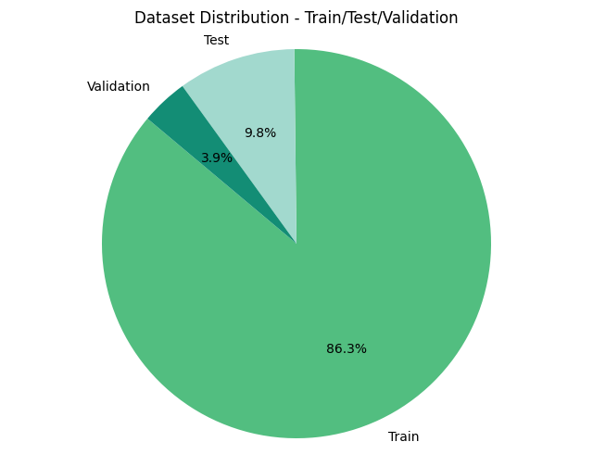
Dataset Description
The dataset comprises three distinct labels: "Healthy," "Powdery," and "Rust," denoting various plant conditions.
Total of 1530 images categorized into train, test, and validation sets for model training and evaluation

Slide 10
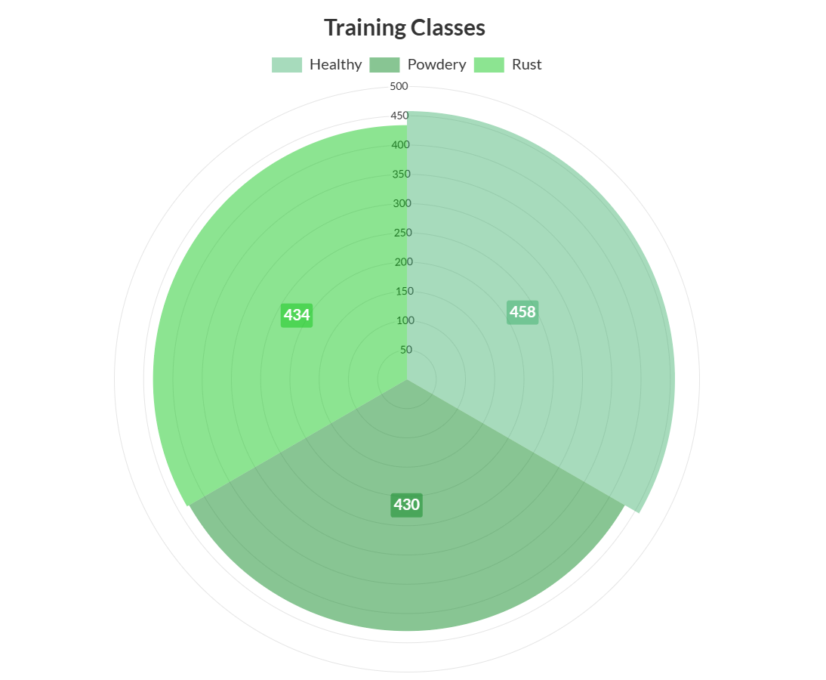
Distribution Across Classes:
Train Set:
'Healthy': 458 images
'Powdery': 430 images
'Rust': 434 images
Test Set:
Each class has 50 images
Validation Set:
Each class has 20 images

Slide 11
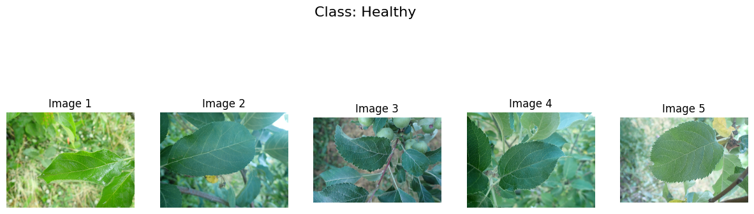
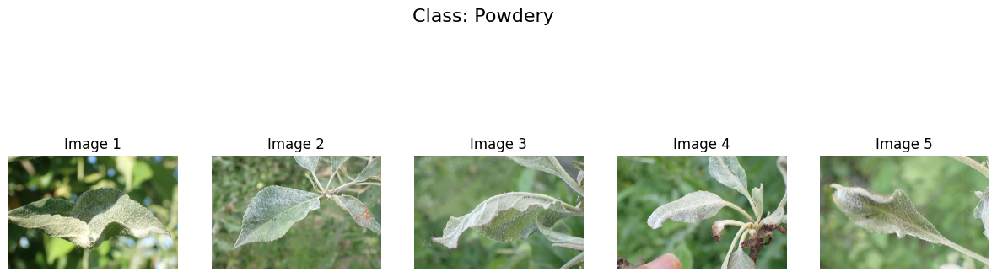
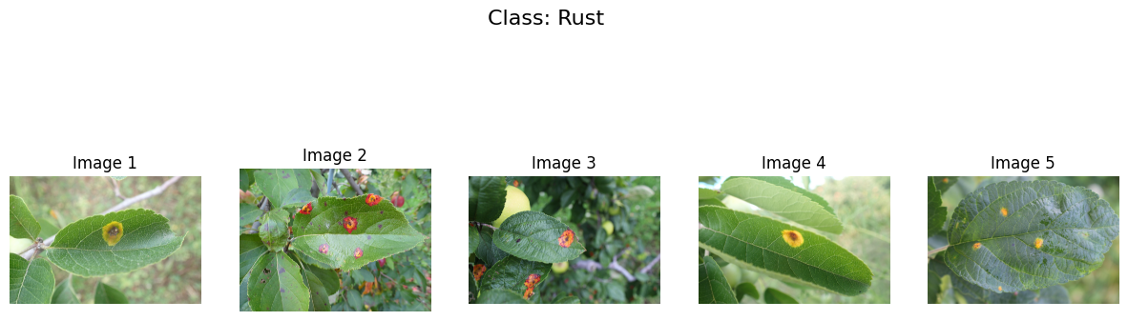

Slide 12
Data Preprocessing
Data Augmentation: Varied dataset by applying transformations (rotation, shift, shear, zoom, flip) to enhance model robustness and generalization.
Resizing: Standardized all images from 4000x2672 to 224x224, ensuring consistent dimensions for computational efficiency during model training.
ROSE
MARY

Slide 13
05
Methodology

Slide 14
Steps Towards Methodology
Select a High quality dataset to minimize preprocessing tasks
Select Proven Models in Image Processing and Pattern Recognition
Select Appropriate Methods to analyze both data and classifiers

Slide 15
Methodology
1.Dataset Selection
2. Preprocessing
Dataset of plant disease selected from Public site with 7.5 usability and CO0 certification
Resizing and using appropriate augmentation parameters to augment the data and increase training
3. Deep Learning Classification
4. Result Comparison
Usage of a custom CNN Model and mobile models MobileNetV2 and Xception on the dataset
Comparison between the training and testing of the datasets

Slide 16
06
Results

Slide 17
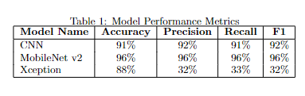
Result Analysis
All models have a good accuracy, with MobileNet Having the best of them
In other Parameters MobileNet has high Precision, Recall and F1 score, CNN is also very close
Xception performs really low in Precision, Recall and F1 score
Comparison of Model Performance Metrics

Slide 18
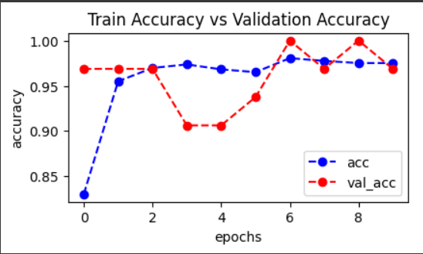
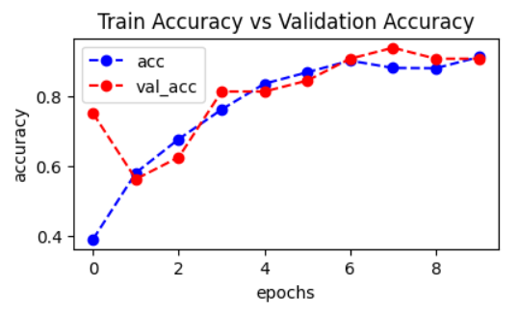
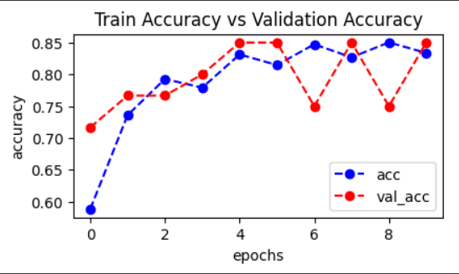
Training Analysis
All the models train relatively growth with the given dataset
MobileNetV2 has a relative stagnant validation rate after the second epoch
Training vs Validation Accuracy for MobileNetV2
Training vs Validation Accuracy for CNN
Training vs Validation Accuracy for Xception

Slide 19
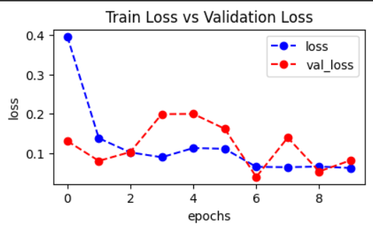
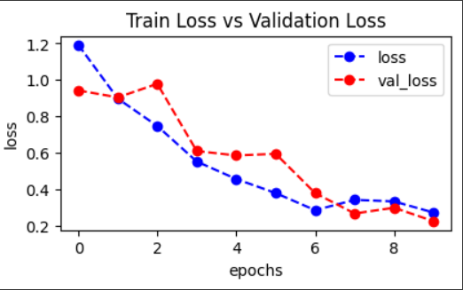
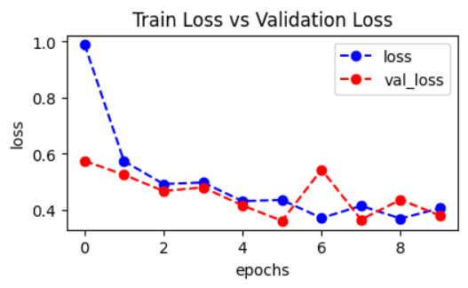
Loss Analysis
All models have low levels of losses
Xception has quite larger loss number than other models
Training vs Validation Loss for MobileNetV2
Training vs Validation Lossfor CNN
Training vs Validation Loss for Xception

Slide 20
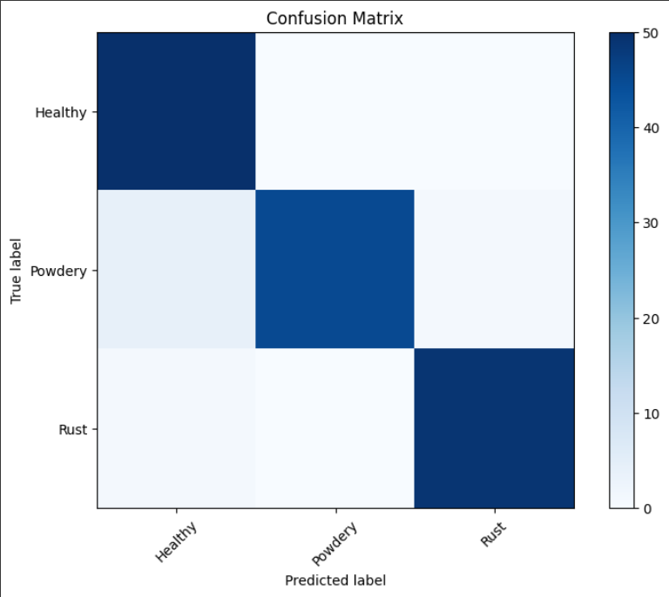
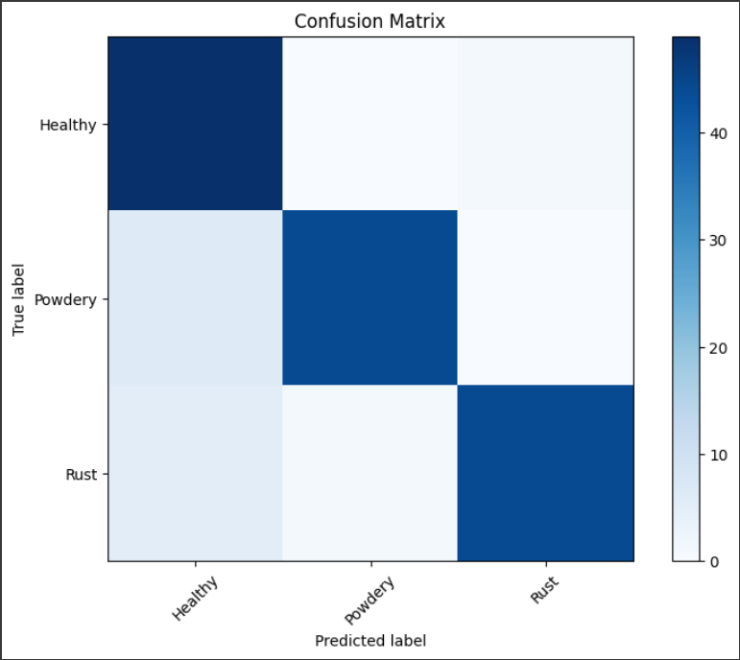
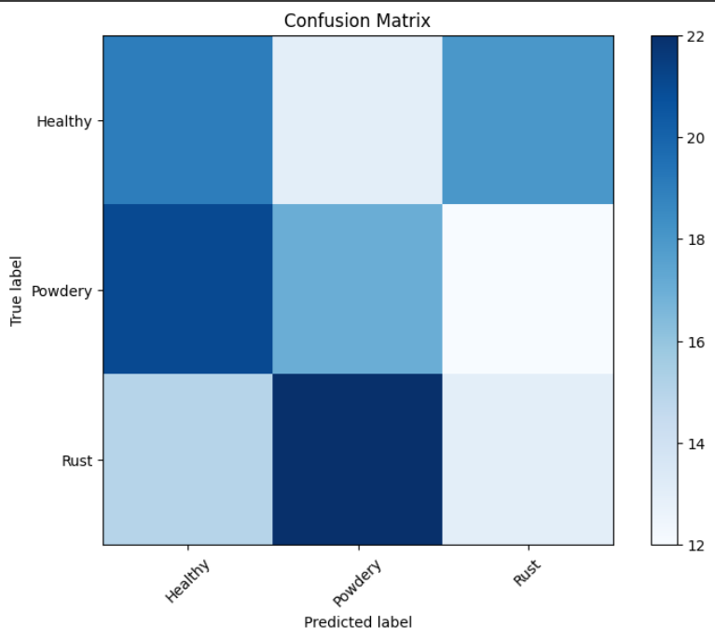
Confusion Matrix Analysis
MobileNetV2 and CNN perform quite similarly while predicting classes
Xception Performs Abysmally while predicting between classes
Exception detects most of the rust class as powdery and healthy
Also detects healthy classes as rust
Confusion Matrix for MobileNetV2
Confusion Matrix for CNN
Confusion Matrix for Xception

Slide 21
07
Future Work

Slide 22
Implementing a few more models
Understanding viability towards making a day to day usable model
Implementing XAI to understand failings of Xcpetion

Slide 23
Thank You!

